Slide 1
Chemistry – Feb 18, 2020
P3 Challenge-
  Polyatomic ion quiz
Objective –
  Intermolecular forces (IMF)
Assignment: Intermolecular Forces Worksheet
Agenda
  Lewis Structures backside HMK review
  Types of IMF in detail
  Evidence of IMF
Get out Lewis Structures Back side
For a HMK check.

Slide 2
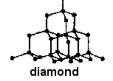
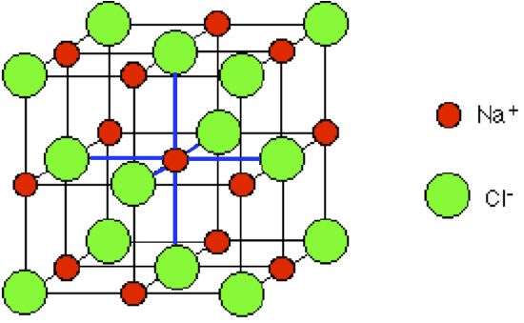
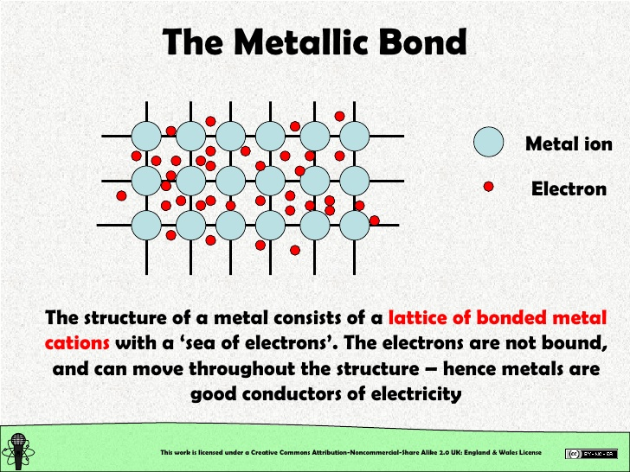
Types of Inter/Intra IMF
Type of force | Relative strength | Present in | Example
Covalent network bonding | Strongest | Only a few select substances | C
Ionic bonding | Very strong | Any ionic substances | NaCl
Metallic bonding | Variable strength, some very strong | Metals and alloys | Fe

Slide 3
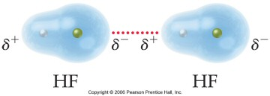
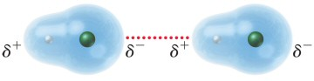
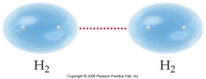
Types of Pure IMF
Type of force | Relative strength | Present in | Example
Hydrogen Bond | Strong | Molecules having H bonded to F, O, or N | HF
Dipole– Dipole force | Moderate | Only polar molecules | CO
Dispersionforce | Weak, but increases with molar mass | All atoms and molecules | H₂

Slide 4
Covalent Network Compounds
Covalent Bonds are most often found intramolecular in molecular solids.
The only time they are found as intermolecular is with a very few covalent network solids, like carbon C (diamond) or silicon dioxide SiO₂ (glass/quartz) or SiC (silicon carbide)
Intramolecular covalent bonds are quite strong, but generally not as strong as ionic bonds.
Intermolecular covalent network bonds are the strongest of all.

Slide 5
Ionic Compounds
The next strongest IMF occur for ionic solids.
Intermolecular forces and intramolecular forces are identical for these compounds.
The IMF is an electrostatic coulomb force that is present between any two oppositely charged species.
a) proportional to both charges. (higher charges, higher IMF)
b) inversely proportional to the square of the distance between charges (bigger atoms, lower IMF)

Slide 6
Metals
Variable strength from strong to very strong. Both inter- and intra-.
In general, a metal bond is formed between atoms of a metallic element. If more than one type of element is present, it is called an alloy.
The bond can be described as fixed positive nuclei with a surrounding soup of electrons. The valence electrons of all nuclei contribute to the soup, but are not delegated to any region or specific nucleus.
These delocalized electrons explain why metals conduct electricity.

Slide 7
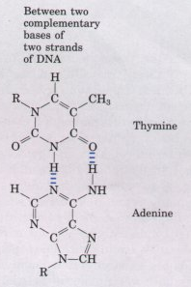
Hydrogen Bonds
Hydrogen Bonds are not bonds but are considered the strongest of the purely intermolecular forces.
H-bonds are found intramolecular only within very large biological molecules (e.g. protein folding, DNA helix).
They are represented on skeletal structures as a half solid, half dotted line.
They are always formed as a hydrogen bridge between two electronegative atoms (N, O, F). The hydrogen must be covalently bonded to one of the two electronegative atoms.
X
H
X

Slide 8
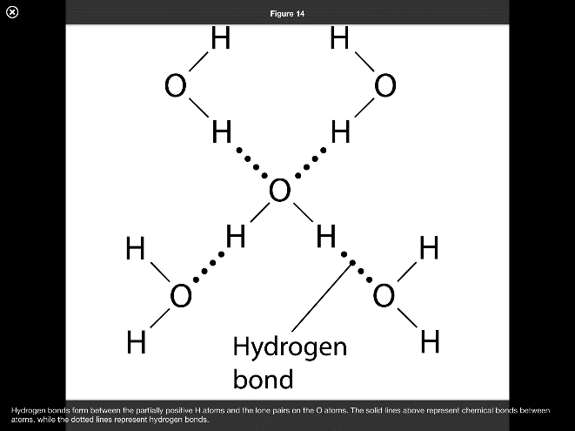
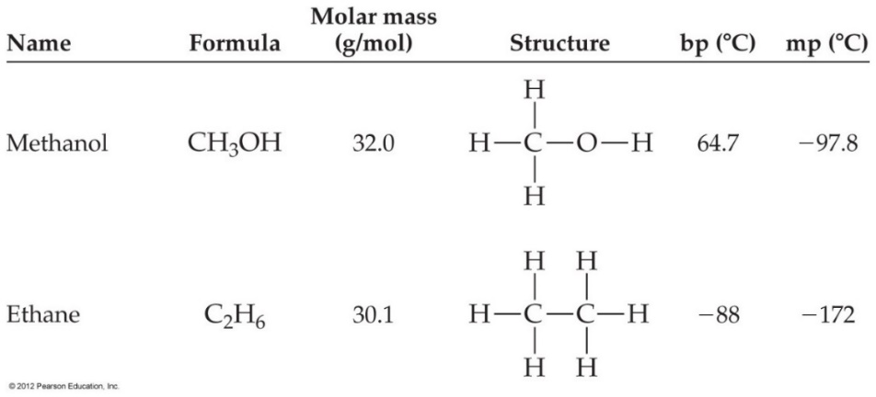
Hydrogen Bonds
Occur in polar molecules that contain a Hydrogen bonded to fluorine, oxygen or nitrogen.
Ex: HF, H₂O, NH₃, alcohols: R-OH, amines: R-NH₂ R = any carbon-hydrogen chain
Water forms the strongest Hydrogen bonds because each oxygen atom can form two hydrogen bonds.

Slide 9
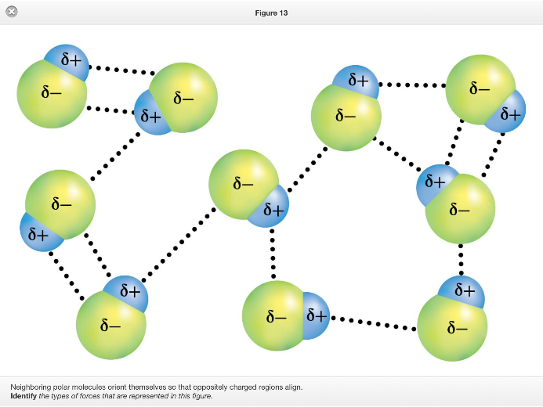
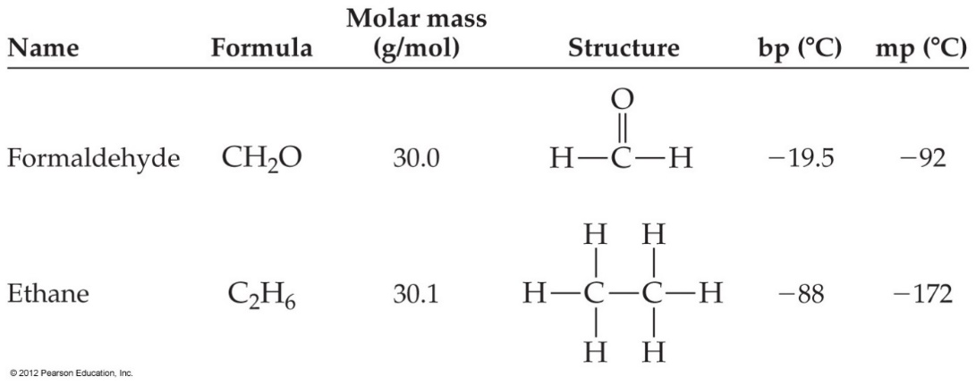
Dipole-dipole forces
Polar bonds create partial charges within their molecules.
The partial charges can then attract one another electrostatically.
These intermolecular forces are called dipole-dipole interactions.

Slide 10
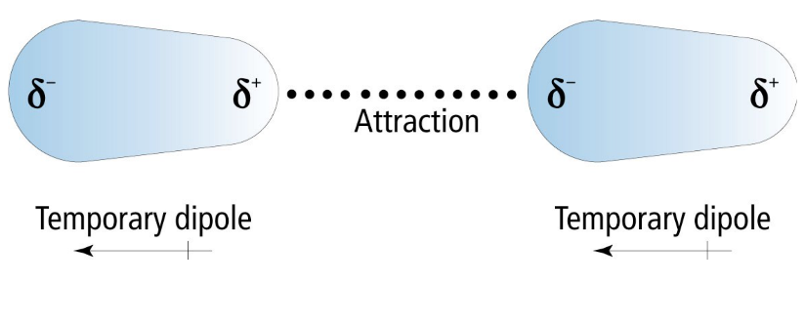
Dispersion/London/ Induced-dipole forces
If no other type of interaction is present, there is still an intermolecular force, though extremely weak. Only force present in atomic solids.
Multiple names for the same phenomenon
  Dispersion forces, London forces (named for Fritz London, not the city), Induced dipole – induced dipole
When two neutral atoms approach one another, the region in-between is avoided by electrons.
This creates a slight induced dipole due to the presence of another nucleus.
These induced dipoles can then interact and attract one another.

Slide 11
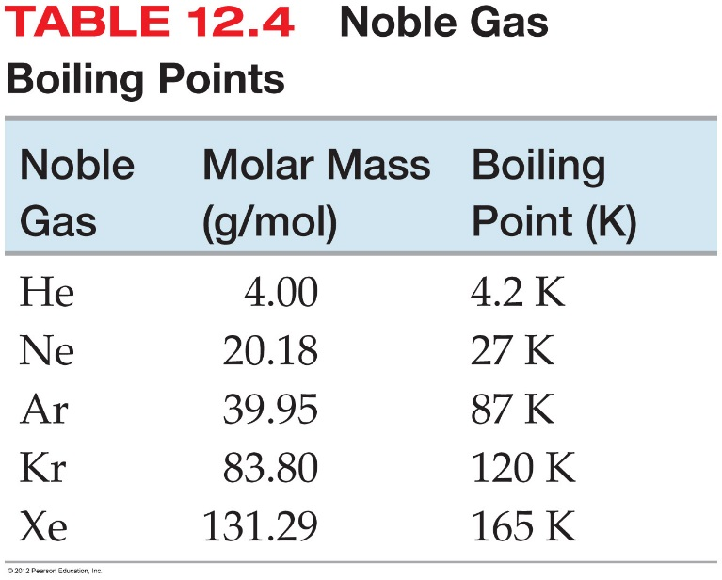
Strength of the Dispersion Force
Ex: Noble gases.
Strength of the dispersion force gets larger with larger molecules.
Strength of the dispersion force gets larger with the longer molecule shapes.

Slide 12
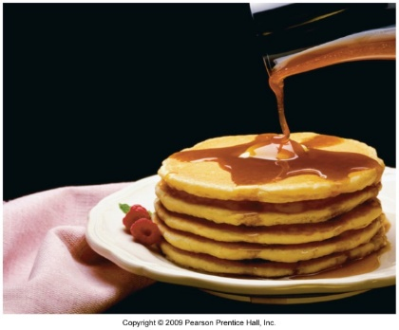
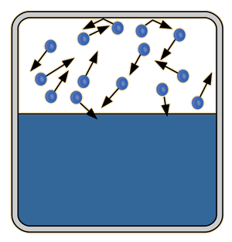
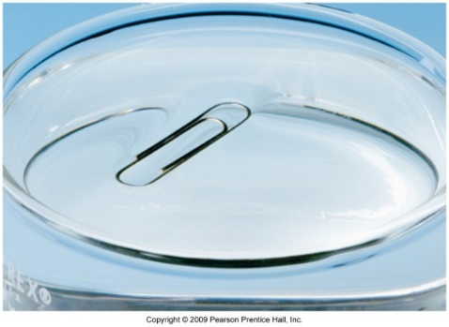
Evidence of IMF
In general, solids have the strongest IMF, gases have the weakest
The stronger the IMF…
  the higher the melting point and the higher the boiling point.
  as a gas, the lower the vapor pressure (partial pressure of vapor in equilibrium with liquid or solid in a closed container at a fixed temperature).
  as a liquid, the higher the viscosity and the higher the surface tension

Slide 13
Exit Slip - Homework
Exit Slip: Which of these molecules would have the highest boiling point? Justify your choice.
  HO-OH, hydrogen peroxide
  CH₃OH, methanol
  CH₃SH, methane thiol
What’s Due? (Pending assignments to complete.)
  Intermolecular forces Worksheet
What’s Next? (How to prepare for the next day)
  Read Holt p385-392

